Slide 1
Optimize Weekly – EP3 [Data Science / ML]
Concurrent Approach : Detection and Segmentation
Presented By:
Shekhar Chaudhary
Feb, 2022

Slide 2
Topic for this week
Concurrent Approach : Detection and Segmentation

Slide 3
Introduction
Concurrent Object Detection and Segmentation model
Research Paper – ‘Simultaneous Detection and Segmentation’
Published by Bharath Hariharan1 , Pablo Arbel´aez1,2 , Ross Girshick1 , and Jitendra Malik1
1 University of California, Berkeley
2 Universidad de los Andes, Colombia

Slide 4
Related Work
In previous approaches, segmentation is used only to localize the detections better. Others have explored using segmentation as a stronger cue. Fidler use the output of a state-of-the-art semantic segmentation approach to score detection better. Mottaghi uses detectors based on non-rectangular patches to both detect and segment objects.
The approaches above were typically built on features such as SIFT or HOG. Recently the computer vision community has shifted towards using convolution neural networks (CNNs).

Slide 5
Aim
To improve performance on the task (‘problem statement’ on future slides), with the use of concurrent detection and segmentation approach.

Slide 6
Object Recognition
Object Recognition is a popular computer-vision research field that is specific to imaging application.
Object Recognition comes in many flavors, two of the most popular being Object Detection and Semantic Segmentation.

Slide 7
Problem Statement
Under semantic segmentation, to assign a category label, the standard metric used to evaluate algorithms converged on pixel IU (intersection over union). This tasks deals with ‘stuff” categories (such as grass, sky, road) and ‘things’ categories (such as cat, person, car) interchangeably.
For ‘things’ categories, there is no notion of object instances.
For example, a typical semantic segmentation algorithm might accurately mark out the dog pixels in the image, but would provide no indication of how many dogs there are, or of the precise spatial extent of any one particular dog.
No Unified Approach

Slide 8
Solution Proposed
Unlike Classical Bounding Box Detection, this model requires a segmentation and not just a box.
Unlike Classical semantic segmentation, we require individual object instances.
To detect all instances of a category in an image and, for each instance, mark the pixels that belong to it.

Slide 9
SDS Algorithm
Proposal Generation
Feature Extraction
Region Classification
Region Refinement
Algorithm is based on classifying region proposals using features extracted from both the bounding box of the region and the region foreground with a jointly trained CNN.
A final refinement step improves segmentation.

Slide 10
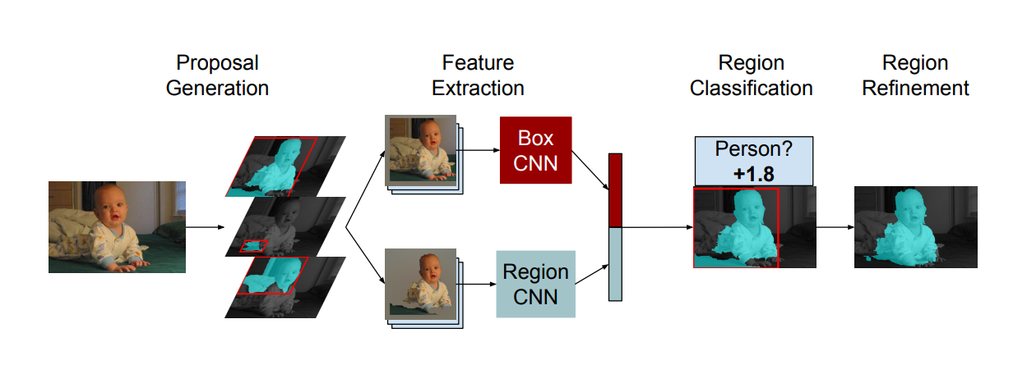
Overview of Pipeline

Slide 11
1. Proposal Generation
We start with Category-independent bottom-up object proposals.
Because we are interested in producing segmentations and not just bounding boxes, we need region proposals.

Slide 12
2. Feature Extraction
We use a convolutional neural network to extract features on each region. We extract features from both the bounding box of the region as well as from the region foreground.
We find that, compared to using the same CNN for both inputs (image windows and region masks), using separate networks where each network is finetuned for its respective role dramatically improves performance. We improve performance further by training both networks jointly, resulting in a feature extractor that is trained end-to-end for the task.

Slide 13
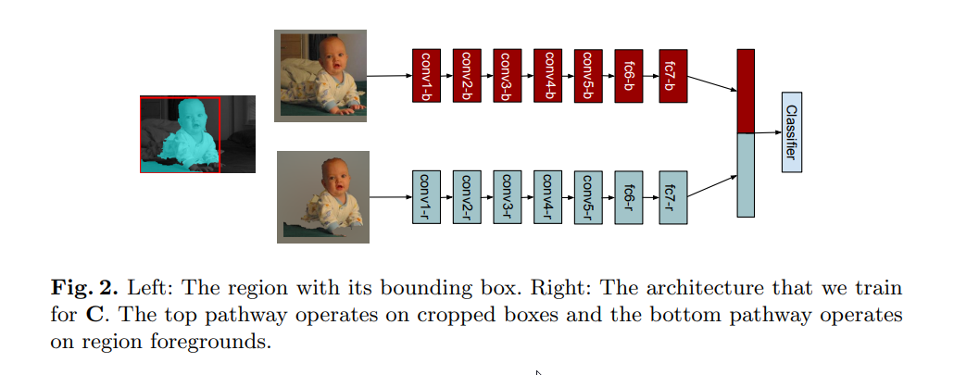
2. Feature Extraction

Slide 14
3. Region Classification
We train an SVM (Support Vector Machine) on top of the CNN features to assign a score for each category to each candidate.

Slide 15
4. Region Refinement
We do non-maximum suppression (NMS) on the scored candidates. Then we use the features from the CNN to produce category-specific coarse mask predictions to refine the surviving candidates. Combining this mask with the original region candidates provides a further boost.

Slide 16
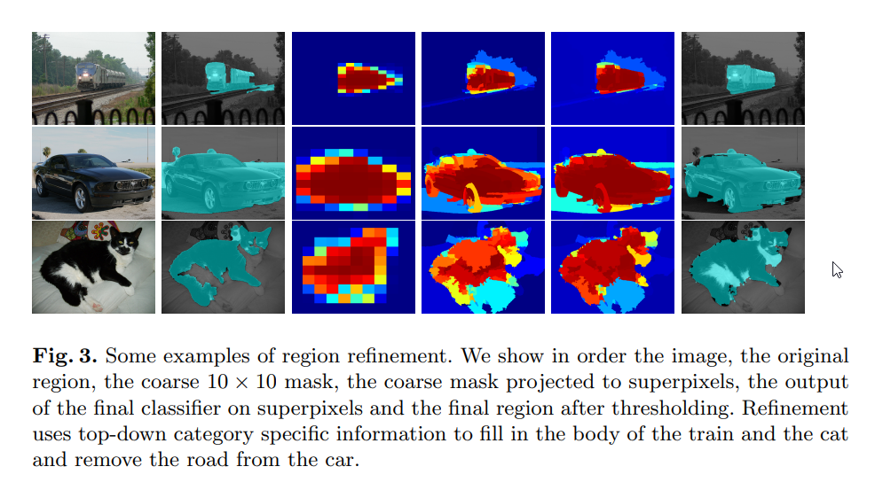
4. Region Refinement

Slide 17
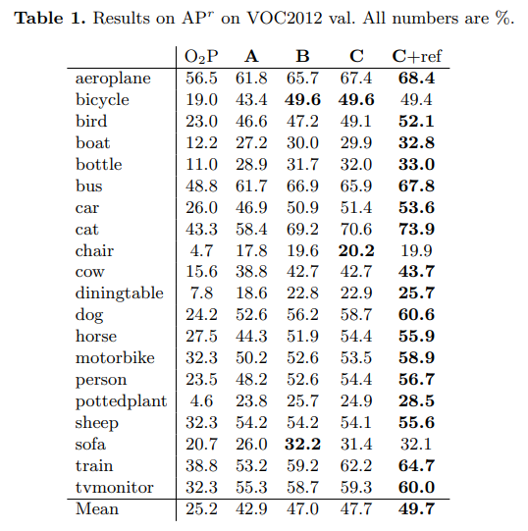
Experiments and Results

Slide 18
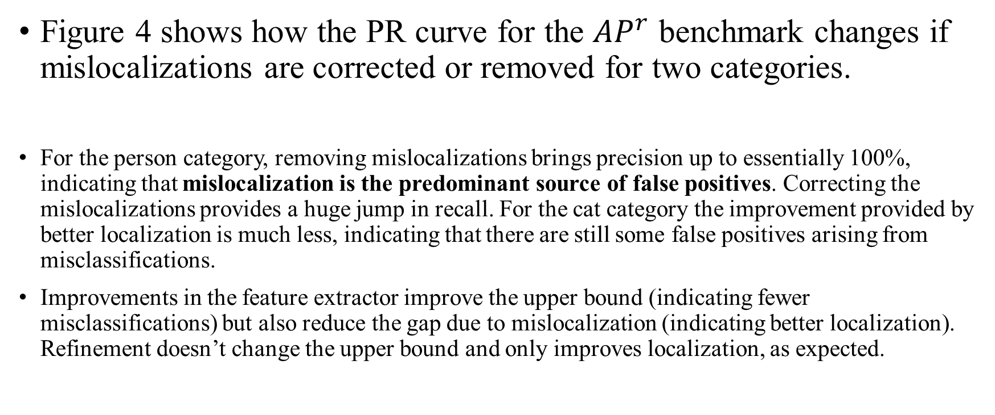
Mislocalization & Misclassification
Figure 4 shows how the PR curve for the ${AP}^{r}$ benchmark changes if mislocalizations are corrected or removed for two categories.
For the person category, removing mislocalizations brings precision up to essentially 100%, indicating that mislocalization is the predominant source of false positives. Correcting the mislocalizations provides a huge jump in recall. For the cat category the improvement provided by better localization is much less, indicating that there are still some false positives arising from misclassifications.
Improvements in the feature extractor improve the upper bound (indicating fewer misclassifications) but also reduce the gap due to mislocalization (indicating better localization). Refinement doesn’t change the upper bound and only improves localization, as expected.

Slide 19
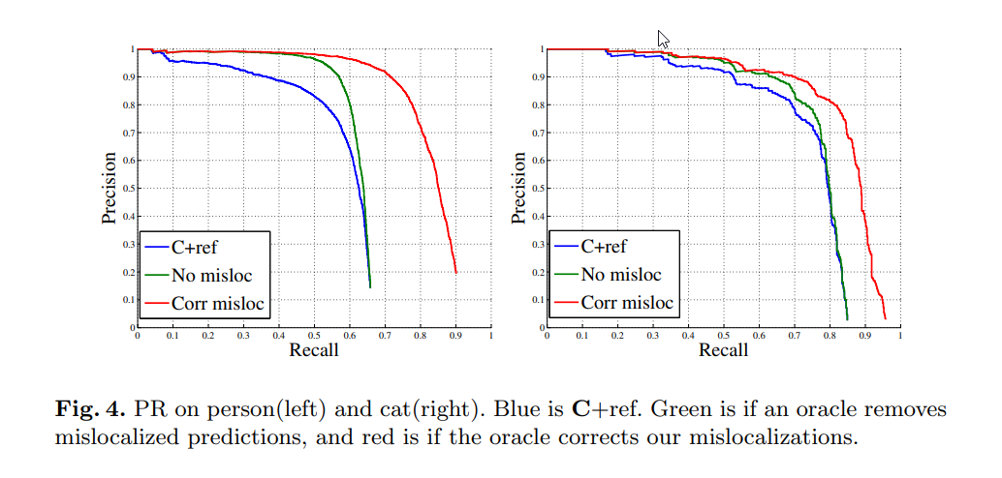
Correct Mislocalizations

Slide 20
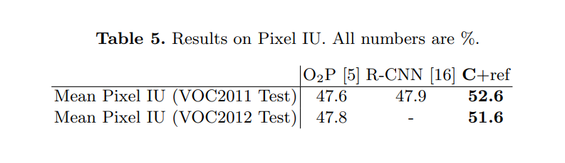
Results on Pixel IU For the semantic segmentation task, we convert the output of our final system (C+ref) into a pixel-level category labeling using the simple pasting scheme proposed by Carreira. We compare to O2P and R-CNN which are the current state-of-the-art on this task. We advance the state-of-the-art by about 5 points, or 10% relative.

Slide 21
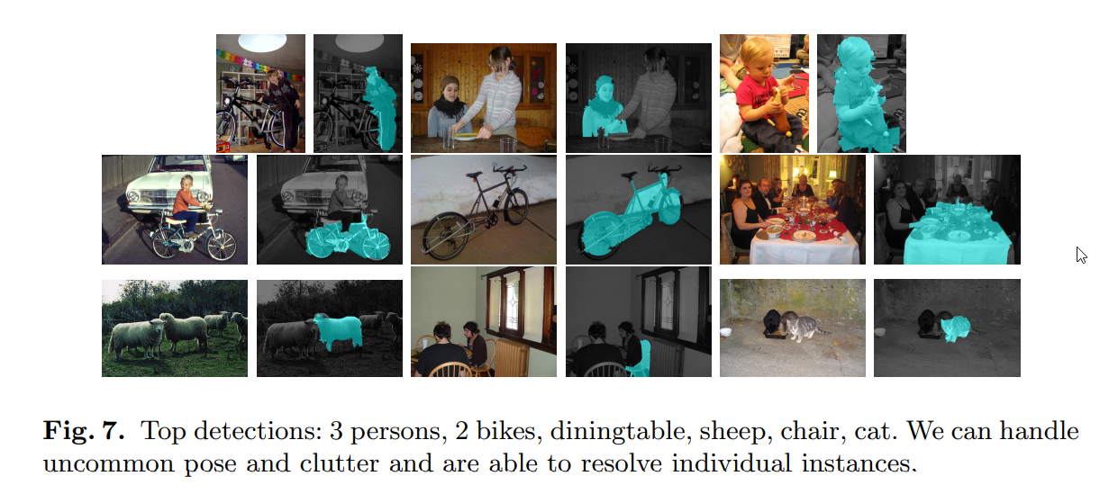
Top Detections

Slide 22
Conclusion
A concurrent method combining two CNNs: a segmentation model and a detection model, allows to significantly improve the object recognition.

Slide 23
References
[1] Bharath Hariharan1 , Pablo Arbel´aez1,2 , Ross Girshick1 , and Jitendra Malik1 ‘‘Simultaneous Detection and Segmentation’’ 1 University of California, Berkeley 2 Universidad de los Andes, Colombia
[2] Damien Grosgeorge, Maxime Arbelot, Alex Goupilleau, Tugdual Ceillier, Renaud Allioux “Concurrent Segmentation And Object Detection CNNs For Aircraft Detection And Identification In Satellite Images” Earthcube, Paris, France
[3] Daniel Bolya, Sean Foley, James Hays, and Judy Hoffman “TIDE: A General Toolbox for Identifying Object Detection Errors” Georgia Institute of Technology

Slide 24
THANK YOU!

